Slide 1
CSc 134
Database Management Systems
3. Relational Data Model and Relational Database Constraints
Ying Jin
Computer Science Department
California state University, Sacramento

Slide 2
Relational Model Concepts
Relational Model presents a database as a collection of relations.
  Table :- Relation
  Row :- Tuple
  Column header :- attribute
Attribute
Student
Name | SSN | Home Phone
Joe Smith | 307-88-2907 | 602-7765543
Barbara Miller | 590-38-6654 | 422-1076031
Tuple

Slide 3
Relational Model
- Domain
Domain: A domain D in the relational model is a set of atomic values.
  Atomic: Each value in the domain is indivisible as far as the relational model is concerned.
Domain:name, data type, format
e.g. USA_Phone_numbers: A character string of the form (ddd)ddd-dddd, where each d is a numeric (decimal) digit and the first three digits form a valid telephone area code.
e.g. employee_age: Possible ages of employee of a company; each must be an integer value between 15 and 80.

Slide 4
Relational Model
- Relation Schema
name of the relation
A relation Schema R(A1,A2,…An) is made up of a relation name R and a list of attributes A1,A2,…,An
  E.g. STUDENT(Name,ssn,phoneNumber)
Domain of Ai is denoted by dom(Ai)
Degree of a relation: number of attributes n of its relation schema

Slide 5
Relational Model
- relation state
A relation (or relation state) of the relation schema R(A1,A2,…An) is denoted by r(R)
  The relation is a set of of n-tuples r={t1,t2,..tm}, where each n-tuple t is an ordered list of values: t=<v1,v2,..vn>
  each value vi, 1=<i<=n, is an element of dom(Ai) or is a special null value.
unknown or may not apply to a tuple

Slide 6
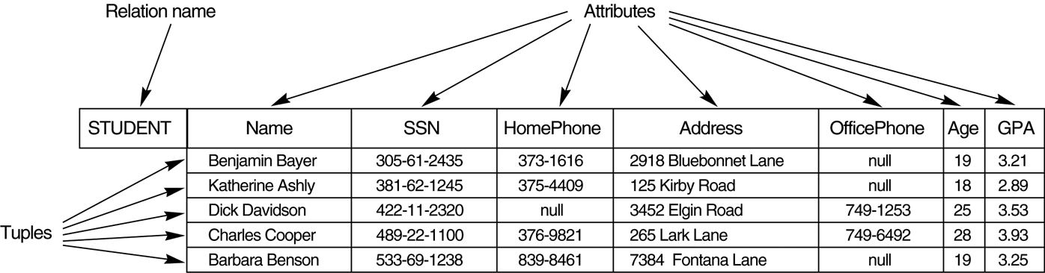

Slide 7
Relational Model
- relation state (Cont.)
r(R) ⊆ (dom(A1) X dom (A2) X … X dom(An))
Tuples are unordered in a relation
A relation cannot have duplicate tuples
Denote cardinality (number of values) of domain D by |D|.
Maximum number of tuples in r(R) is
|dom(A1)| * |dom(A2)| * … * |dom(An)|

Slide 8
Relational Model
- Attribute value
Value v_{i} in tuple t for attribute A_{i}
  t[Ai] or t.A_{i}
  E.g. Given tuple t=<‘Joe Smith’, ‘307-88-2907’, ‘602-7765543’>
    t[Name]=<‘Joe Smith’>
    t.Name=<‘Joe Smith’>
    t[SSN,Name]=<‘307-88-2907’, ‘Joe Smith’>
    t.(SSn,Name)=<‘307-88-2907’, ‘Joe Smith’>
An attribute A of a relation R can be presented as R.A
  STUDENT.Name

Slide 9
Constraints
- Category
Constraints on databases can generally be divided into three main categories:
  Inherent model-based constraints
    constraints that are inherent in the data model
    e.g.
      Ordering of tuples in a relation
      Relational model represents facts about both entities and relationship uniformly a relation
      A relation cannot have duplicate tuples

Slide 10
Constraints
- Category (Cont.)
  Schema-based constraints
    can be directly expressed in the schemas of the data model, typically by DDL.
  Application-based constraints
    cannot be directly expressed in the schemas of the data model
    must be expressed and enforced by application program.
Another important category of constraints: Data Dependencies
  functional dependencies and multivalued dependencies.

Slide 11
Schema-based constraints
Constraints are conditions that must hold on all valid relation states.
Domain constraints
Key constraints
Constraints on nulls
Entity integrity constraints
Referential integrity constraints

Slide 12
Domain constraints
Within each tuple, the value of each attribute A must be an atomic value from the domain dom(A).
Data type of domain
  Integer
  boolean
  ...

Slide 13
Key constraints
SK is a superkey of R, if for any two distinct tuples t1 and t2 in a relation state r of R, we have the constraint that
t1[SK] ‡ t2[SK]
Key constraint, Unique constraint
  No two distinct tuples in any state r or R can have the same value for SK.
e.g. {SSN, Name, Age}

Slide 14
Key
A key is a minimal superkey – a superkey such that removal of any attribute from K results in a set of attributes that is not a superkey.
e.g. {ssn}
A relation schema may have more than one key, each of the keys is called a candidate key.
e.g. fig

Slide 15
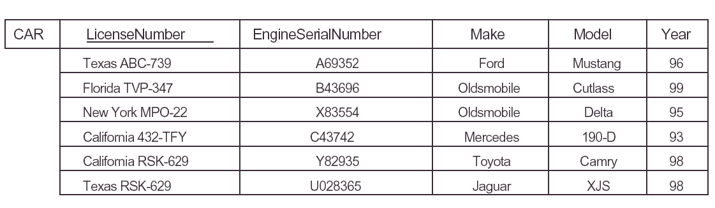

Slide 16
Primary Key
Designate one of the candidate keys as the primary key of the relation.
The choice of primary key from candidate keys is arbitrary
It is better to choose a primary key with a single attribute or a small number of attributes.
The primary key attributes are underlined.

Slide 17
Constraints on NULL values
A constraint specifies that null values are or are not permitted
e.g. employee Name is constrained to be NOT NULL.

Slide 18
Entity integrity constraint
Entity integrity constraint: No primary key value can be null
Because the primary key value is used to identify individual tuples in a relation.
Involve a single relation

Slide 19
Referential integrity constraints
Specify a relationship among tuples in two relations: the referencing relation and the referenced relation.
Informally:
  refer to an existing tuple

Slide 20
Foreign Key
A set of attributes FK in relation schema R1 is a foreign key of R1 that references relation R2 if it satisfies two rules:
  1. The attributes in FK have the same domain(s) as the primary key attributes PK of R2
  2. A value of FK in a tuple t1 of the current state r1(R1) either occurs as a value of PK for some tuple t2 in the current state r2(R2), or is NULL.
  t1[FK] = t2[PK].
  t1 references or refers to t2.

Slide 21
Referential integrity constraint definition
If the two conditions hold, the referencing integrity constraint from R1 to R2 is said to hold.
A referential integrity constraint can be displayed in a relational database schema as a directed arc from R₁.FK to R₂.

Slide 22
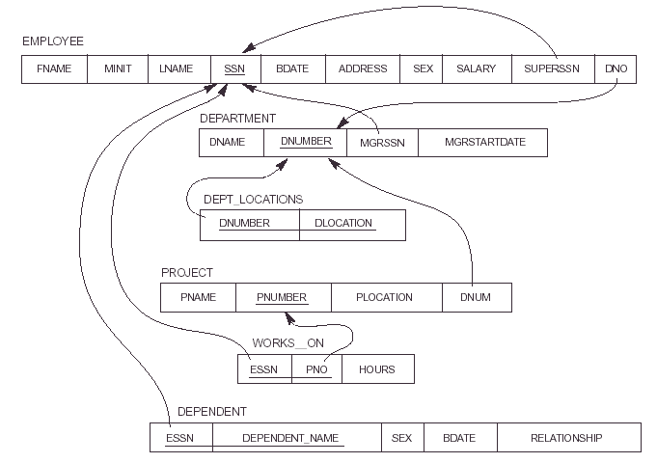
Referential integrity constraint example
dno=1?
dno=null?

Slide 23
Refer to its own relation
A foreign key can refer to its own relation.
e.g. superssn

Slide 24
Application-based constraints
Semantic integrity constraints
e.g. “The salary of an employee should not exceed the salary of the employee’s supervisor”
Constraint specification language
  e.g. trigger, assertions
Check within application programs

Slide 25
Relational Database Schemas
A relational database schema S is a set of relation schemas
S = {R1, R2,..., Rm}
and a set of integrity constraints IC.
A relational database state DB of S is a set of relation states
DB = {r1,r2,..., rm}
such that each ri is a state of Ri and ri satisfy the IC.

Slide 26
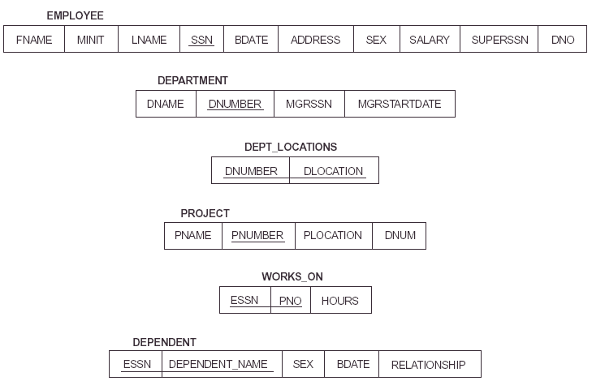
Example of relational database schema

Slide 27
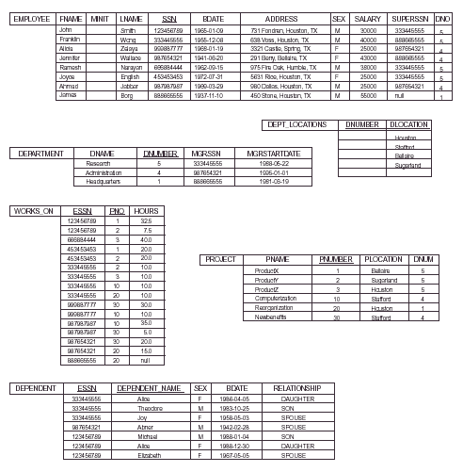
One possible database state for the company schema

Slide 28
Valid /invalid state
When we refer to a relational database, we implicitly include its schema and its current state.
A database state satisfies all the constraints in IC is called a valid state.
A database state does not obey all the integrity constraints is called an invalid state.

Slide 29
Update Operations on Relations
INSERT a tuple.
DELETE a tuple.
MODIFY a tuple.
Integrity constraints should not be violated by the update operations.
Updates may propagate to cause other updates automatically. This may be necessary to maintain integrity constraints.

Slide 30
Update Operations on Relations (Cont.)
In case of integrity violation, several actions can be taken:
  Cancel the operation that causes the violation (REJECT option)
  Perform the operation but inform the user of the violation
  Trigger additional updates so the violation is corrected (CASCADE option, SET NULL option)
  Execute a user-specified error-correction routine

Slide 31
Constraint violation
- Insert
Insert can violate ______
  Domain constraints
  Key constraints
  Entity integrity constraints
  Referential integrity constraints
Reject the insertion in case of constraint violation

Slide 32
Constraint violation
- Delete
Can violate referential integrity
In case of violation
  Reject the deletion
  Attempt to cascade the deletion
  Modify the referencing attribute values the cause the violation
    Set to null
      foreign key is part of the primary key.
    Change to reference another valid tuple
  Specify it in DDL

Slide 33
Constraint violation
- Update
Modify neither a primary key nor a foreign key
  Check new value in the correct domain
Update a primary key or a foreign key
  Delete + Insert
  Can use DDL to specify how to handle update

Slide 34
These slides are based on the textbook:
R. Elmaseri and S. Navathe, Fundamentals of Database Systems, 7th Edition, Addison-Wesley.

